Slide 1

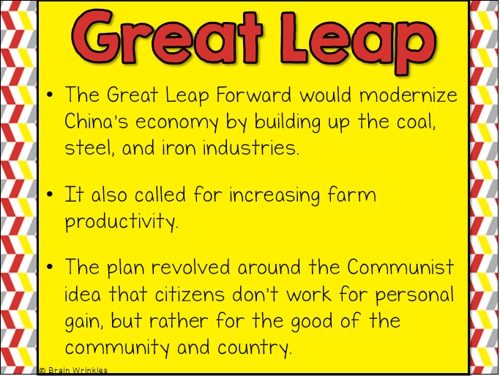
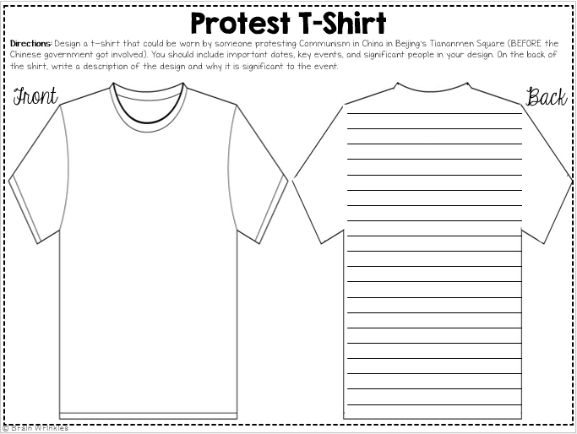
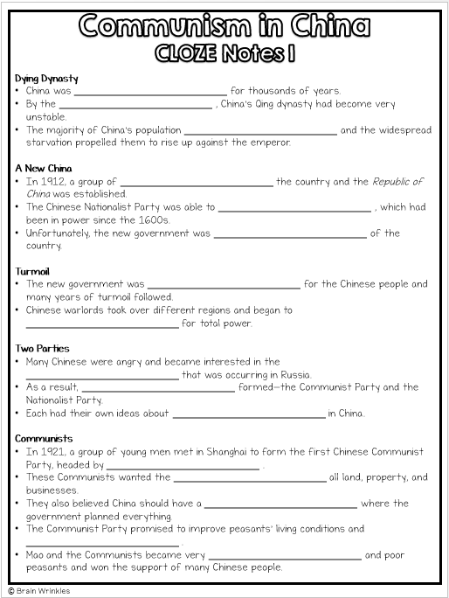

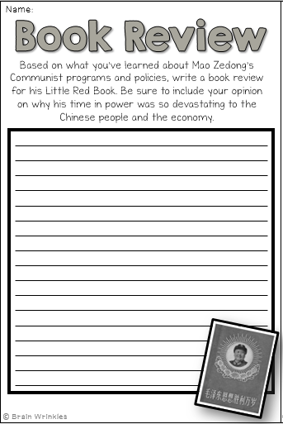
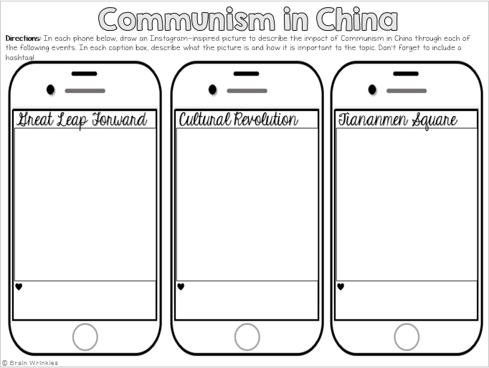
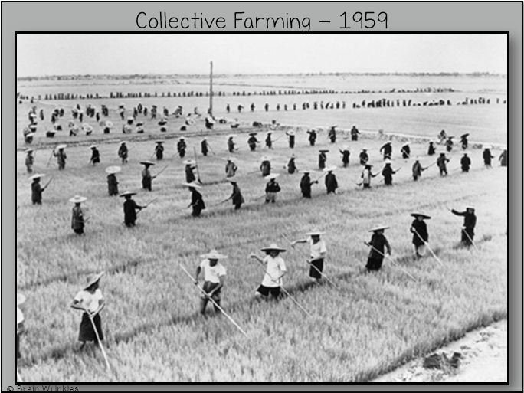
COMMUNISM
IN CHINA
COMMUNISM
IN CHINA
Presentation, Graphic Organizers, & Activities

Slide 2
STANDARDS:
SS7H3 Analyze continuity and change in Southern and Eastern Asia.
d. Describe the impact of communism in China in terms of Mao Zedong, the Great Leap Forward, the Cultural Revolution, and Tiananmen Square.
© Brain Wrinkles

Slide 3
Dying Dynasty
China was __________________________ for thousands of years.
By the __________________________ , China’s Qing dynasty had become very unstable.
The majority of China’s population __________________________ and the widespread starvation propelled them to rise up against the emperor.
A New China
In 1912, a group of __________________________ the country and the Republic of China was established.
The Chinese Nationalist Party was able to __________________________ , which had been in power since the 1600s.
Unfortunately, the new government was __________________________ of the country.
Turmoil
The new government was __________________________ for the Chinese people and many years of turmoil followed.
Chinese warlords took over different regions and began to __________________________ for total power.
Two Parties
Many Chinese were angry and became interested in the __________________________ that was occurring in Russia.
As a result, __________________________ formed—the Communist Party and the Nationalist Party.
Each had their own ideas about __________________________ in China.
Communists
In 1921, a group of young men met in Shanghai to form the first Chinese Communist Party, headed by __________________________ .
These Communists wanted the __________________________ all land, property, and businesses.
They also believed China should have a __________________________ where the government planned everything.
The Communist Party promised to improve peasants’ living conditions and __________________________ .
Mao and the Communists became very __________________________ and poor peasants and won the support of many Chinese people.
© Brain Wrinkles
Communism in China
CLOZE Notes 1

Slide 4
Nationalists
The Nationalists were led by __________________________ .
They wanted China to have a __________________________ where citizens could make economic decisions and own their own businesses, factories, and property.
Civil War
In 1927, __________________________ in China.
Mao led over 600,000 people on the __________________________ through the mountains for over 6,000 miles to avoid being captured by the Nationalist government.
The two sides __________________________ throughout China until 1935 when they joined forces to resist Japanese invasion.
Control
The truce ended and the relationship __________________________ after World War II.
The __________________________ the Communist Party and the United States helped the Chinese Nationalists.
Communism __________________________ until they finally gained control of the Nationalist government.
P.R.C.
On October 1, 1949, Mao declared the creation of the People’s Republic of China, a __________________________ .
Mao was appointed head of China’s government and had __________________________ over the country.
He became extremely popular with many Chinese when he took __________________________ and gave it to poor peasants.
Economy
At this time, China had __________________________ and relied heavily on agriculture.
Mao had a big challenge of increasing wealth among China’s citizens because the __________________________ .
In 1958, the Communist government __________________________ that they hoped would solve this problem.
© Brain Wrinkles
Communism in China
CLOZE Notes 2

Slide 5
Great Leap
The __________________________ would modernize China’s economy by building up the coal, steel, and iron industries.
It also called for increasing __________________________ .
The plan revolved around the Communist idea that citizens don’t work for personal gain, but rather for the __________________________ and country.
Communes
Under the Great Leap Forward, the __________________________ all businesses, factories, and private property.
The government __________________________ where up to 25,000 people lived and worked as a group.
The government was in control of the people’s __________________________ .
Rations
Workers __________________________ they worked, nor did they get to keep the goods they created.
Goods made in the communes were __________________________ and then distributed to citizens.
A ration system was in place in the communes and each family was __________________________ of food, clothing, and other necessary items.
Did It Work?
The Great Leap Forward was a __________________________ .
Within a year, the plan __________________________ , environmental issues, and government corruption.
Instead of growing stronger, China’s __________________________ during this time period.
Problems
The Communist __________________________ of managing the communes and industries.
__________________________ damaged the farming regions, and the farming communes could not feed the starving country.
Corrupt government officials __________________________ of rationed food and goods.
© Brain Wrinkles
Communism in China
CLOZE Notes 3

Slide 6
Outcomes
From 1958-1960, one of the __________________________ struck China.
The Great Leap Forward left the Chinese people ill-prepared to handle it and about __________________________ during this time.
Individual rights and freedoms also suffered during this time, and many people did not like the government __________________________ for them.
Result
When the Great Leap Forward failed, many Chinese __________________________ .
They __________________________ to take care of and provide for the country.
More and more people began calling for __________________________ .
Cultural Revolution
Mao realized that he was __________________________ of the country.
In response, he created a new program called the __________________________ in 1966.
Mao promised that the revolution would restore the __________________________ and bring Chinese culture back to the country.
Red Guard
In reality, Mao created the Cultural Revolution to __________________________ to his Communist rule.
He urged students to __________________________ on anyone who opposed communism.
The students were organized into an army known as the __________________________ .
They attacked, imprisoned, and even killed those __________________________ with Mao.
Culture?
Any artist, writer, professor, or religious leader who __________________________ was tortured, imprisoned, or killed.
Monuments, statues, and artwork created before the Cultural Revolution __________________________ .
Schools and factories shut down, and the __________________________ .
Fear and distrust of the government __________________________ in China.
© Brain Wrinkles
Communism in China
CLOZE Notes 4

Slide 7
End
The purpose of the Cultural Revolution was to restore ancient Chinese culture and traditions; but in reality, it served as a __________________________ to Mao’s Communist rule.
Mao declared the Cultural Revolution complete in 1969, although __________________________ until Mao’s death in 1976.
As a result of this program, many Chinese became more __________________________ of the Communist government.
New Leader
After Mao’s death, China’s new leader, Deng Xiaoping, __________________________ , but the government still stuck to its communist roots.
Xiaoping allowed farmers to own their own land, opened China to foreign investments, and he allowed some __________________________ .
Control
Despite the economic reforms, the Chinese people were still __________________________ like freedom of speech, freedom of religion, or the right to a fair trial.
The government continued to __________________________ those who spoke out against Communism.
Protests
In 1989, over 10,000 Chinese students gathered to protest __________________________ in Tiananmen Square in the capital city of Beijing.
They filled the square for 7 weeks, __________________________ Communism and calling for a move towards democracy.
They __________________________ throughout China.
Tiananmen
On June 4, 1989, the Chinese government had enough and __________________________ against the peaceful protestors.
Soldiers and tanks were sent into the square and __________________________ that refused to leave.
Hundreds of __________________________ , and the tragedy became known as the Tiananmen Square Massacre.
Pressure
The Tiananmen Square Massacre __________________________ to China’s poor treatment of human rights.
  Countries around the world condemned this violence and began urging China to __________________________ of its citizens.
  Finally, the international pressure began to have some effect and the Chinese government began __________________________ in human rights.
© Brain Wrinkles
Communism in China
CLOZE Notes 5

Slide 8


Communism in
CHINA
© Brain Wrinkles

Slide 9
Dying Dynasty
China was ruled by emperors for thousands of years.
By the early 1900s, China’s Qing dynasty had become very unstable.
The majority of China’s population lived in poverty and the widespread starvation propelled them to rise up against the emperor.
© Brain Wrinkles

Slide 10
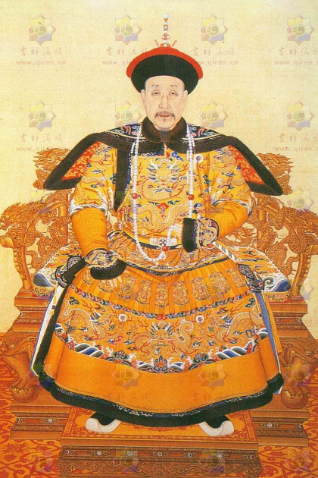
© Brain Wrinkles

Slide 11
A New China
In 1912, a group of nationalists took over the country and the Republic of China was established.
The Chinese Nationalist Party was able to overthrow the Qing Dynasty, which had been in power since the 1600s.
Unfortunately, the new government was too weak to keep control of the country.
© Brain Wrinkles

Slide 12
Turmoil
The new government was failing to provide for the Chinese people and many years of turmoil followed.
Chinese warlords took over different regions and began to fight between themselves for total power.
© Brain Wrinkles

Slide 13
Two Parties
Many Chinese were angry and became interested in the Communist Revolution that was occurring in Russia.
As a result, two political parties formed—the Communist Party and the Nationalist Party.
Each had their own ideas about solving starvation and poverty in China.
© Brain Wrinkles

Slide 14
Communists
In 1921, a group of young men met in Shanghai to form the first Chinese Communist Party, headed by Mao Zedong.
These Communists wanted the government to control all land, property, and businesses.
They also believed China should have a command economy where the government planned everything.
© Brain Wrinkles

Slide 15
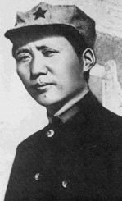
"Revolution is not a dinner party, nor an essay, nor a painting, nor a piece of embroidery; it cannot be so refined, so leisurely and gentle, so temperate, kind, courteous, restrained and magnanimous. A revolution is an insurrection, an act of violence by which one class overthrows another.”
~Mao Zedong 1927
© Brain Wrinkles

Slide 16
Communists
The Communist Party promised to improve peasants’ living conditions and bring food to the poor.
Mao and the Communists became very popular with farmers and poor peasants and won the support of many Chinese people.
© Brain Wrinkles

Slide 17
Nationalists
The Nationalists were led by Chiang Kai-shek.
They wanted China to have a market economy where citizens could make economic decisions and own their own businesses, factories, and property.
© Brain Wrinkles

Slide 18
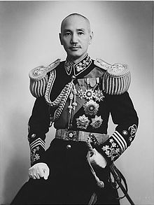
Chiang Kai-shek
© Brain Wrinkles

Slide 19
Civil War
In 1927, civil war broke out in China.
Mao led over 600,000 people on the Long March through the mountains for over 6,000 miles to avoid being captured by the Nationalist government.
The two sides continued to fight throughout China until 1935 when they joined forces to resist Japanese invasion.
© Brain Wrinkles

Slide 20
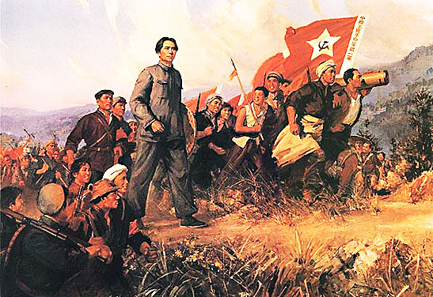
The Long March
© Brain Wrinkles

Slide 21
Control
The truce ended and the relationship became tense again after World War II.
The Soviet Union supported the Communist Party and the United States helped the Chinese Nationalists.
Communism gained more and more supporters until they finally gained control of the Nationalist government.
© Brain Wrinkles

Slide 22
P.R.C.
On October 1, 1949, Mao declared the creation of the People’s Republic of China, a communist state.
Mao was appointed head of China’s government and had almost complete control over the country.
He became extremely popular with many Chinese when he took land from the wealthy and gave it to poor peasants.
© Brain Wrinkles

Slide 23
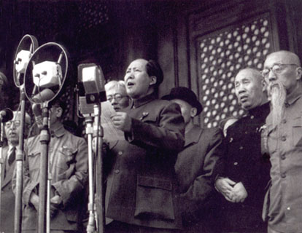
Mao Zedong declares the founding of the People's Republic of China on October 1st, 1949.
© Brain Wrinkles

Slide 24
Economy
At this time, China had very little industry and relied heavily on agriculture.
Mao had a big challenge of increasing wealth among China’s citizens because the economy was so weak.
In 1958, the Communist government developed an economic plan that they hoped would solve this problem.
© Brain Wrinkles

Slide 25
Great Leap
The Great Leap Forward would modernize China’s economy by building up the coal, steel, and iron industries.
It also called for increasing farm productivity.
The plan revolved around the Communist idea that citizens don’t work for personal gain, but rather for the good of the community and country.
© Brain Wrinkles

Slide 26
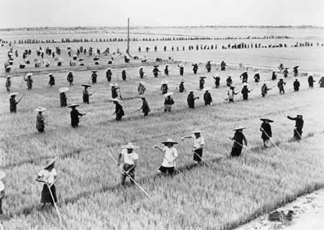
Collective Farming - 1959
© Brain Wrinkles

Slide 27
Communes
Under the Great Leap Forward, the government took over all businesses, factories, and private property.
The government set up communes where up to 25,000 people lived and worked as a group.
The government was in control of the people’s work schedules and social lives.
© Brain Wrinkles

Slide 28
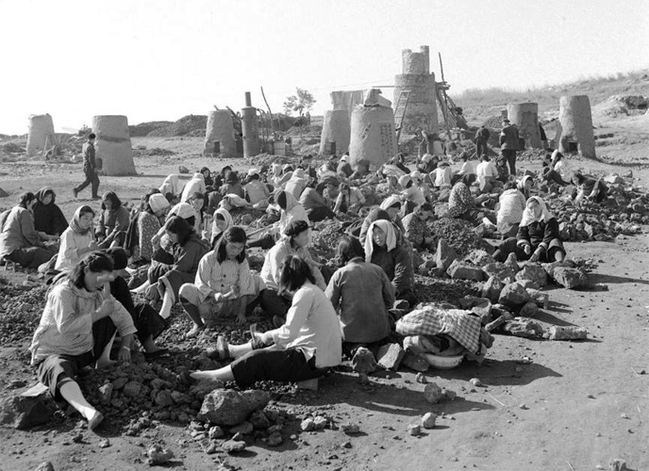
Women working together during the Great Leap Forward.
© Brain Wrinkles

Slide 29
Rations
Workers did not own the land they worked, nor did they get to keep the goods they created.
Goods made in the communes were collected by the government and then distributed to citizens.
A ration system was in place in the communes and each family was given set amounts of food, clothing, and other necessary items.
© Brain Wrinkles

Slide 30
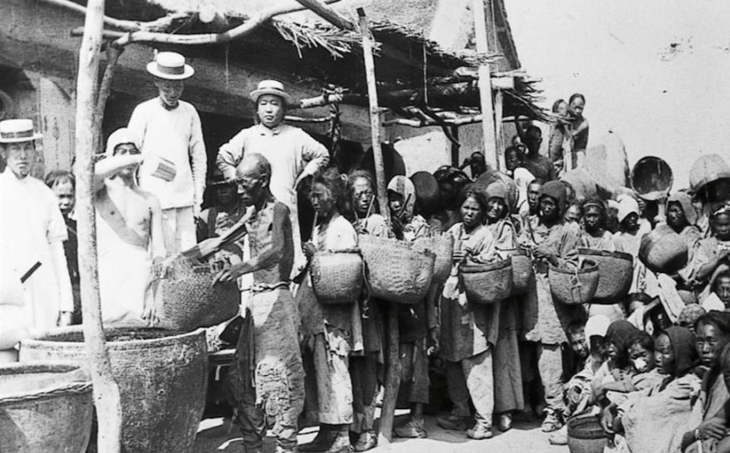
Collecting Rations
© Brain Wrinkles

Slide 31
Did It Work?
The Great Leap Forward was a huge disaster.
Within a year, the plan failed due to poor management, environmental issues, and government corruption.
Instead of growing stronger, China’s economy actually shrank during this time period.
© Brain Wrinkles

Slide 32
Problems
The Communist government did a terrible job of managing the communes and industries.
Droughts and floods damaged the farming regions, and the farming communes could not feed the starving country.
Corrupt government officials kept more than their share of rationed food and goods.
© Brain Wrinkles

Slide 33
Outcomes
From 1958-1960, one of the largest famines in history struck China.
The Great Leap Forward left the Chinese people ill-prepared to handle it and about 20 million citizens died during this time.
Individual rights and freedoms also suffered during this time, and many people did not like the government making all of the decisions for them.
© Brain Wrinkles

Slide 34
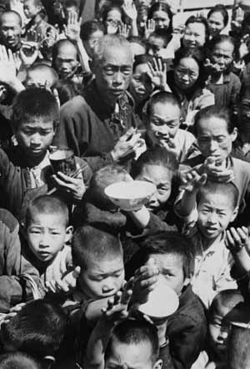
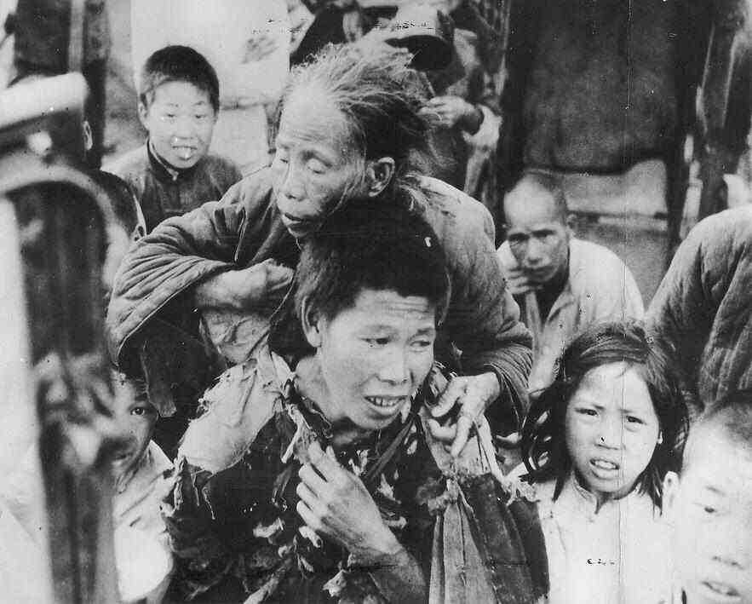
The Great Famine
© Brain Wrinkles

Slide 35
Result
When the Great Leap Forward failed, many Chinese lost confidence in Mao’s leadership.
They questioned his ability to take care of and provide for the country.
More and more people began calling for government reforms.
© Brain Wrinkles

Slide 36
Cultural
Revolution
Mao realized that he was losing control of the country.
In response, he created a new program called the Cultural Revolution in 1966.
Mao promised that the revolution would restore the spirit of Communism and bring Chinese culture back to the country.
© Brain Wrinkles

Slide 37
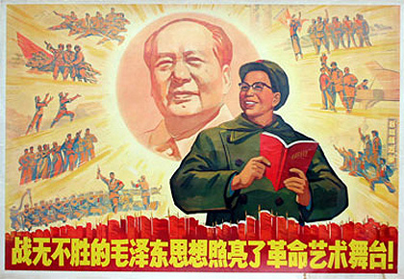
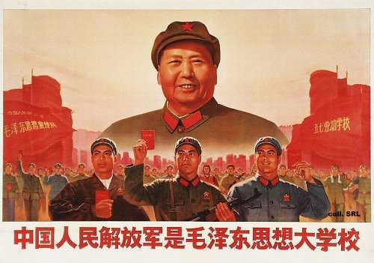
Cultural Revolution Propaganda
© Brain Wrinkles

Slide 38
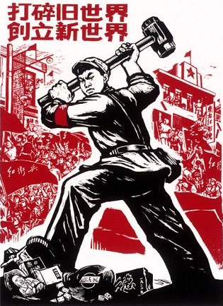
“Destroy the Old World. Forge the New World.”
Cultural Revolution Propaganda Poster
© Brain Wrinkles

Slide 39
Red Guard
In reality, Mao created the Cultural Revolution to stop all opposition to his Communist rule.
He urged students to quit school and wage war on anyone who opposed communism.
The students were organized into an army known as the Red Guards.
They attacked, imprisoned, and even killed those suspected of not agreeing with Mao.
© Brain Wrinkles

Slide 40
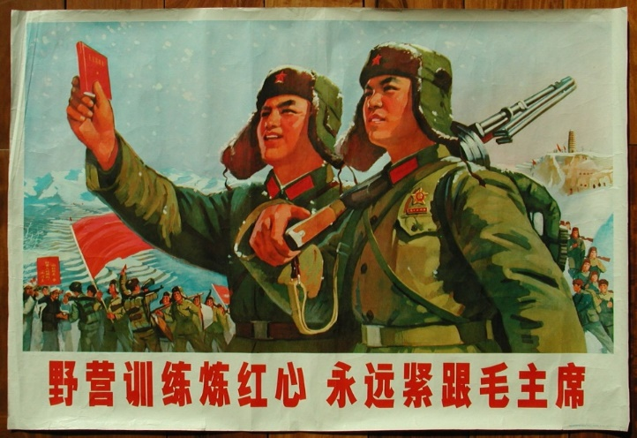
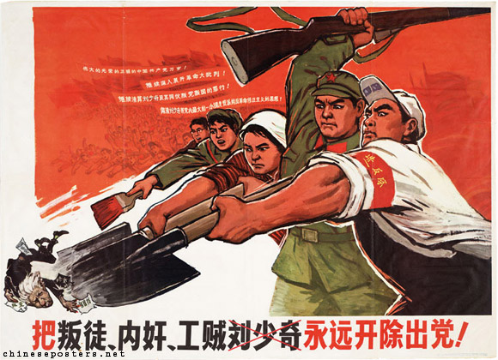
Red Guard Propaganda Posters
© Brain Wrinkles

Slide 41
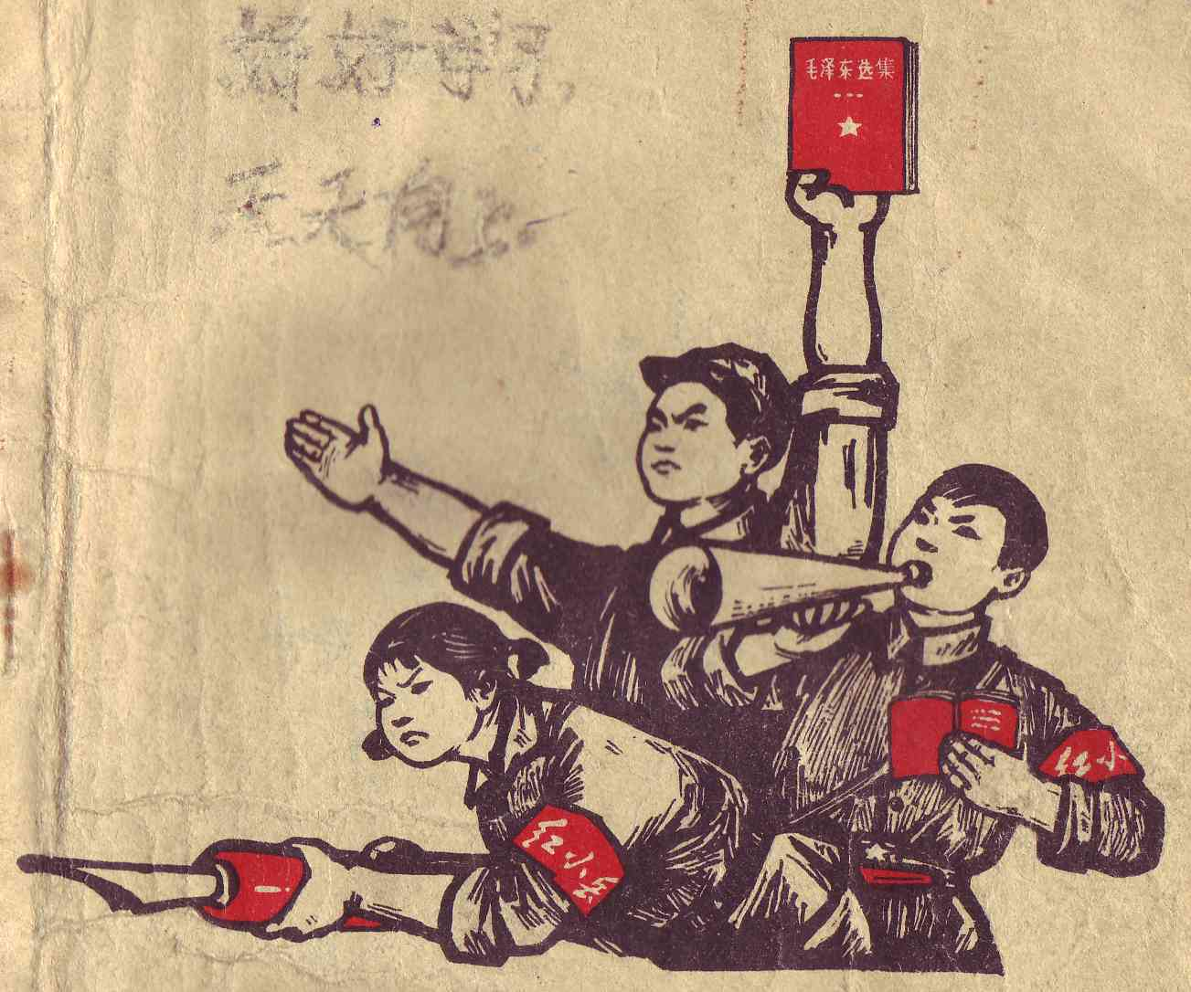
Cover of an elementary school textbook – image shows 3 young Red Guards.
© Brain Wrinkles

Slide 42
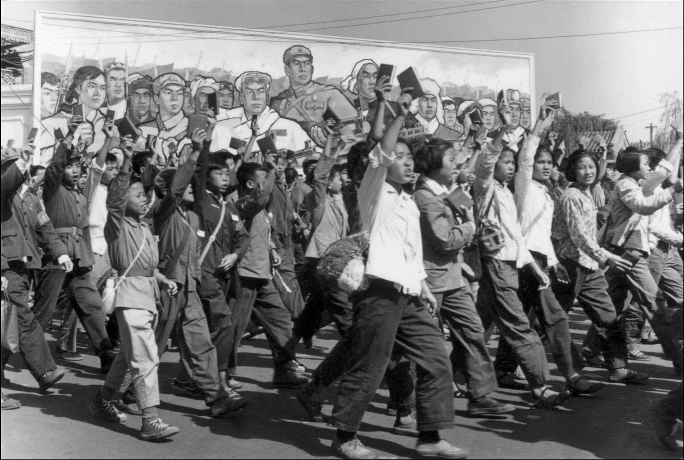
© Brain Wrinkles

Slide 43
Culture?
Any artist, writer, professor, or religious leader who opposed Communism was tortured, imprisoned, or killed.
Monuments, statues, and artwork created before the Cultural Revolution were destroyed.
Schools and factories shut down, and the economy grew weaker.
Fear and distrust of the government created mass chaos in China.
© Brain Wrinkles

Slide 44
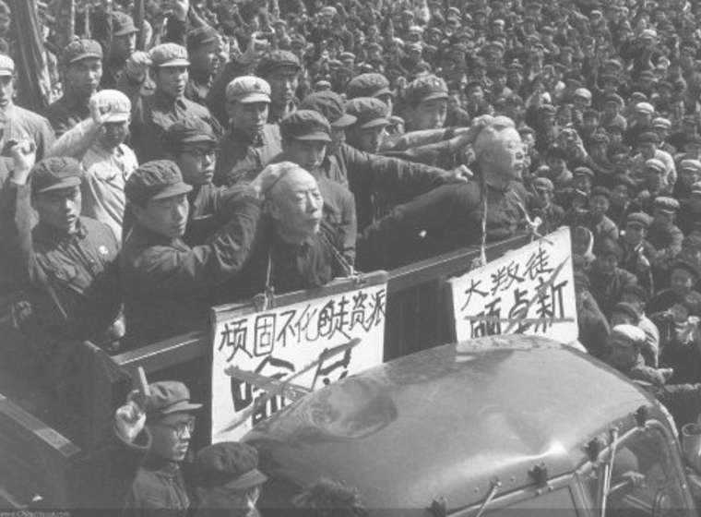
© Brain Wrinkles

Slide 45
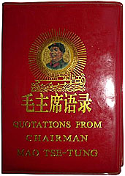
The Little Red Book
This was a collection of excerpts from past speeches and publications. It was required for citizens to read, memorize, and carry this with them at all times.
© Brain Wrinkles

Slide 46
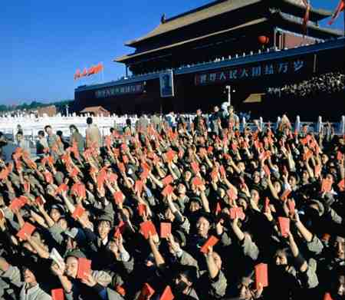
© Brain Wrinkles

Slide 47
It served
End
The purpose of the Cultural Revolution was to restore ancient Chinese culture and traditions; but in reality, it served as a brutal way to eliminate opposition to Mao’s Communist rule.
Mao declared the Cultural Revolution complete in 1969, although many of the attacks continued until Mao’s death in 1976.
As a result of this program, many Chinese became more fearful and distrustful of the Communist government.
© Brain Wrinkles

Slide 48
It served
New Leader
After Mao’s death, China’s new leader, Deng Xiaoping, made many reforms to Mao’s rules, but the government still stuck to its communist roots.
Xiaoping allowed farmers to own their own land, opened China to foreign investments, and he allowed some private businesses to open.
© Brain Wrinkles

Slide 49
It served
Control
Despite the economic reforms, the Chinese people were still not given basic human rights like freedom of speech, freedom of religion, or the right to a fair trial.
The government continued to imprison and torture those who spoke out against Communism.
© Brain Wrinkles

Slide 50
It served
Protests
In 1989, over 10,000 Chinese students gathered to protest China’s corrupt Communist government in Tiananmen Square in the capital city of Beijing.
They filled the square for 7 weeks, peacefully protesting Communism and calling for a move towards democracy.
They inspired other protests throughout China.
© Brain Wrinkles

Slide 51
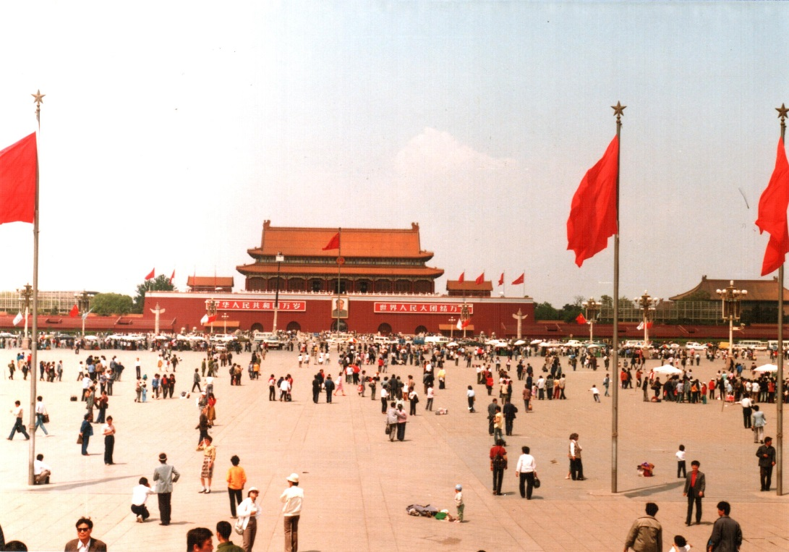
Tiananmen Square 1988
© Brain Wrinkles

Slide 52
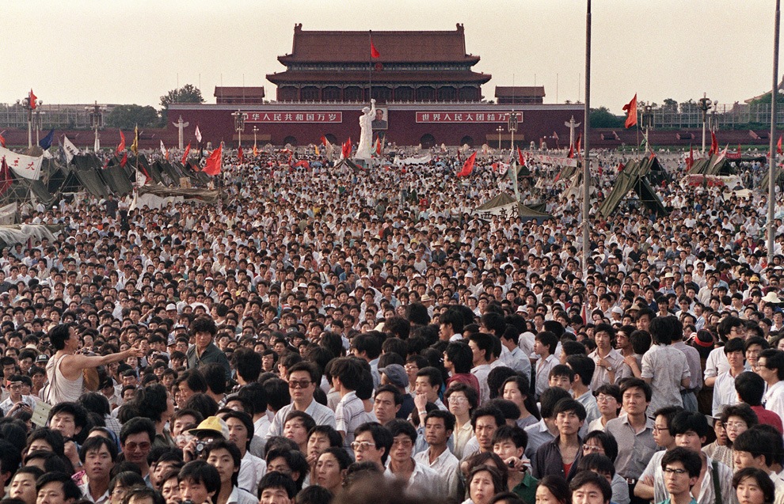
Tiananmen Square 1989
© Brain Wrinkles

Slide 53
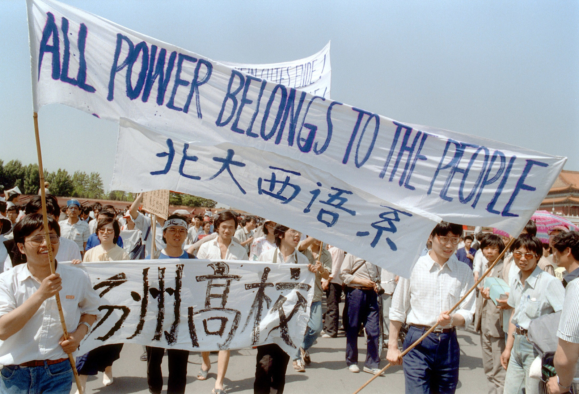
© Brain Wrinkles

Slide 54
It served
Tiananmen
On June 4, 1989, the Chinese government had enough and took action against the peaceful protestors.
Soldiers and tanks were sent into the square and opened fire on the protestors that refused to leave.
Hundreds of innocent lives were lost, and the tragedy became known as the Tiananmen Square Massacre.
© Brain Wrinkles

Slide 55
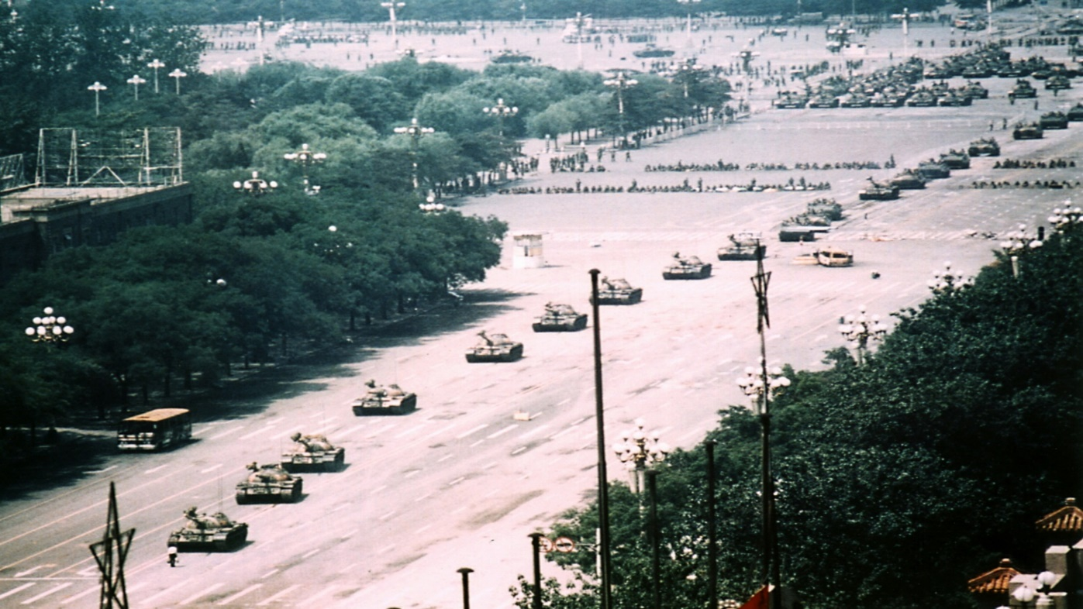
Tanks Rolling In
© Brain Wrinkles

Slide 56
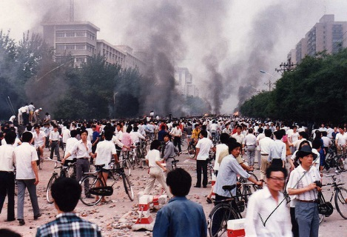
© Brain Wrinkles

Slide 57
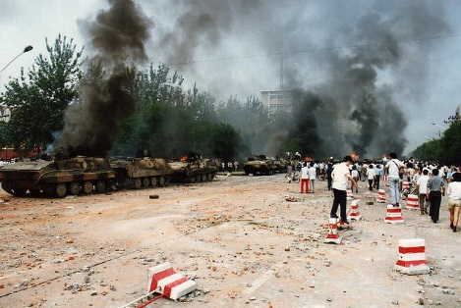
© Brain Wrinkles

Slide 58
It served
Pressure
The Tiananmen Square Massacre raised international attention to China’s poor treatment of human rights.
  Countries around the world condemned this violence and began urging China to improve the human rights of its citizens.
  Finally, the international pressure began to have some effect and the Chinese government began making some real reforms in human rights.
© Brain Wrinkles

Slide 59
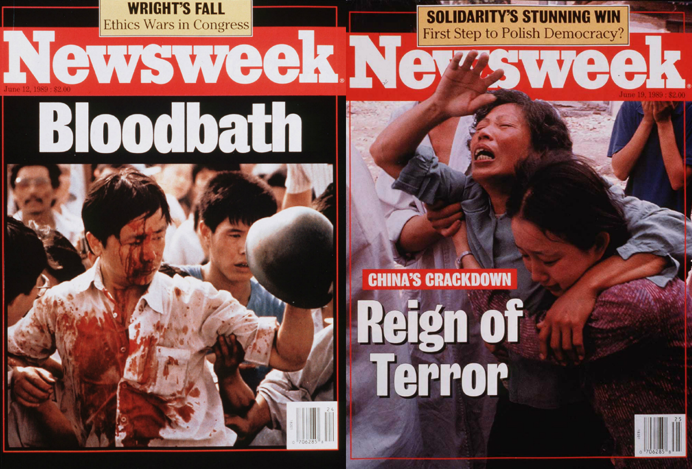
© Brain Wrinkles

Slide 60
1. After the emperor was overthrown, what two political parties emerged in China?
2. Who was the leader of the Communist party?
3. What did the Communist party promise to bring to China?
4. When was the Communist state of the People’s Republic of China established?
5. Why did poor peasants support the Chinese Communist Party?
6. Which country was China’s key ally throughout the mid-1900s?
7. What was the name of the economic plan that the Chinese government developed in order to boost China’s economy?
8. Describe the Great Leap Forward (include communes and rations):
9. What three problems caused the Great Leap Forward to fail within a year?
10. What was the biggest consequence of the Great Leap Forward?
© Brain Wrinkles
Communism in China
Comprehension Check

Slide 61
11. What was the Cultural Revolution?
12. What was the true purpose of the Cultural Revolution?
13. Who was the Red Guard and what did they do?
14. What was the impact of the Cultural Revolution on many Chinese?
15. In 1989, where did many Chinese students come together to peacefully protest Communism?
16. What happened here when the government go involved?
17. What was the international response to the Tiananmen Square Massacre?
© Brain Wrinkles
Communism in China
Comprehension Check

